Slide 1
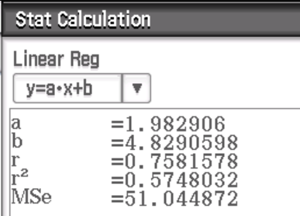
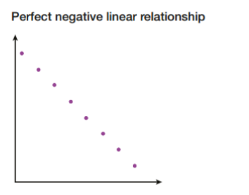
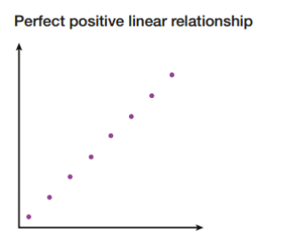
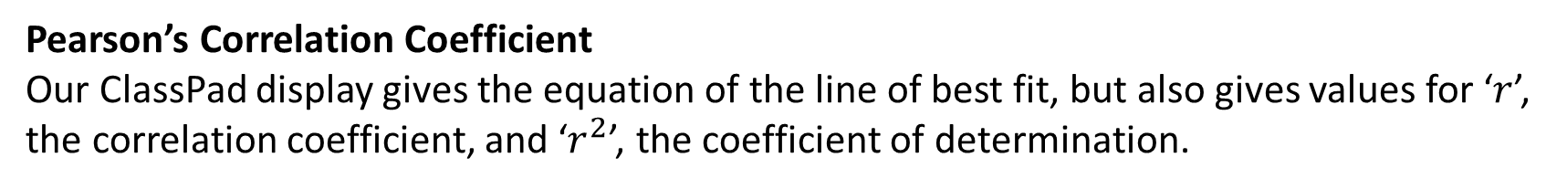
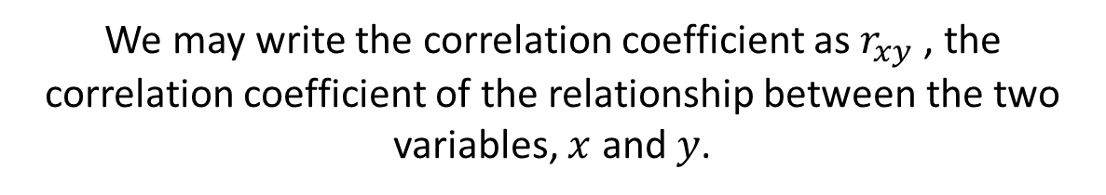
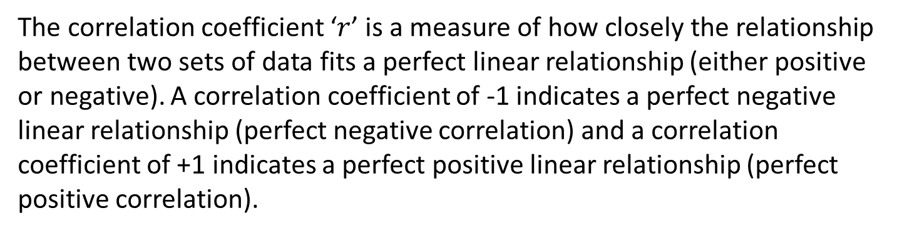
Unit 3 Chapter 2B
Previously, we have described the relationship (or correlation) between two variables as being a strong positive or weak negative etc. We can state the strength of a relationship using a correlation coefficient (from -1 to 1) to describe the relationship more accurately.
Pearson’s Correlation Coefficient
Our ClassPad display gives the equation of the line of best fit, but also gives values for ‘$r$’, the correlation coefficient, and ‘$r^{2}$’, the coefficient of determination.
The correlation coefficient ‘$r$’ is a measure of how closely the relationship between two sets of data fits a perfect linear relationship (either positive or negative). A correlation coefficient of -1 indicates a perfect negative linear relationship (perfect negative correlation) and a correlation coefficient of +1 indicates a perfect positive linear relationship (perfect positive correlation).
We may write the correlation coefficient as $r_{xy}$, the correlation coefficient of the relationship between the two variables, $x$ and $y$.

Slide 2
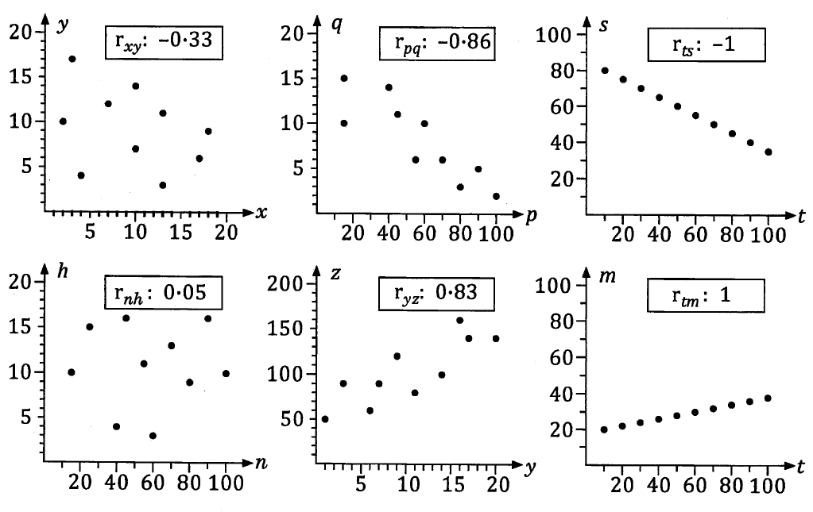
Unit 3 Chapter 2B
The further away from 0 the correlation coefficient is (in either direction), the closer towards a perfect linear relationship the two variables considered in the scatter plot are.

Slide 3
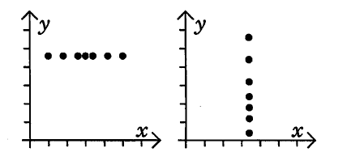
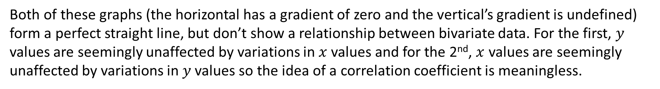
Unit 3 Chapter 2B
The further away from 0 the correlation coefficient is (in either direction), the closer towards a perfect linear relationship the two variables considered in the scatter plot are.
Both of these graphs (the horizontal has a gradient of zero and the vertical’s gradient is undefined) form a perfect straight line, but don’t show a relationship between bivariate data. For the first, $y$ values are seemingly unaffected by variations in $x$values and for the 2nd, $x$ values are seemingly unaffected by variations in $y$ values so the idea of a correlation coefficient is meaningless.

Slide 4
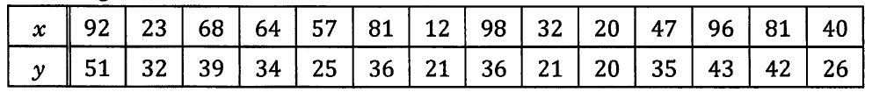
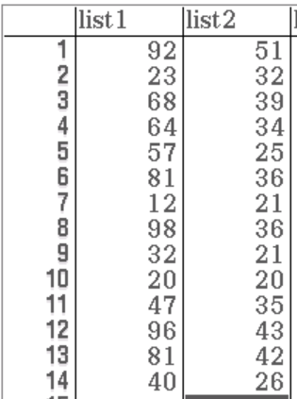
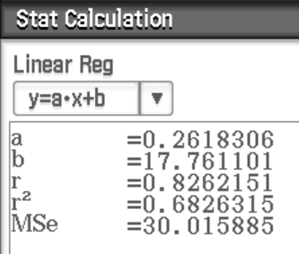
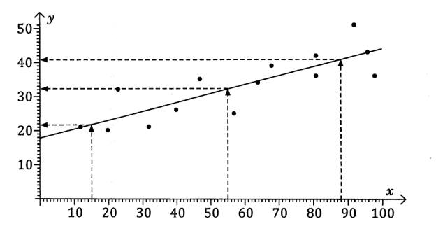
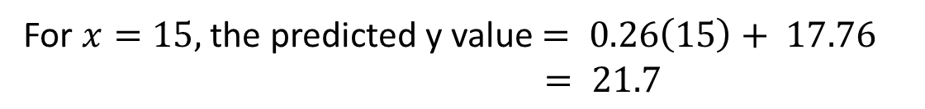
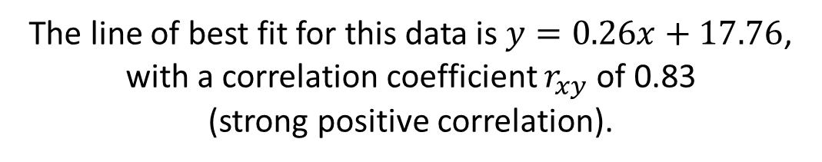
Unit 3 Chapter 2B
The line of best fit for this data is $y=0.26x+17.76$, with a correlation coefficient $r_{xy}$of 0.83
(strong positive correlation).
For $x=15,$ the predicted y value $= 0.26\left(15\right)+ 17.76$
$= 21.7$
For $x=55,$ the predicted y value $=32.2$
For $x=88,$ the predicted y value $=40.8$

Slide 5
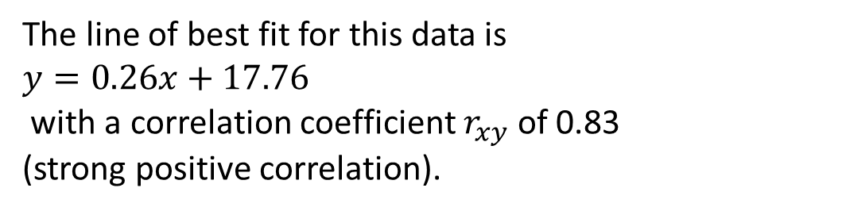
Unit 3 Chapter 2B
The line of best fit for this data is
$$y=0.26x+17.76$$
with a correlation coefficient $r_{xy}$of 0.83
(strong positive correlation).
We can be reasonably confident of the validity of our predicted values as:
The scatter plot suggests the data fits a linear model.
The value of r= 0.83 shows quite strong positive linear correlation.
A reasonable amount of points are involved.
All 3 of our predicted values involve interpolation (fall within range of data).
For $x=15,$ the predicted y value $= 21.7$
For $x=55,$ the predicted y value $=32.2$
For $x=88,$ the predicted y value $=40.8$

Slide 6
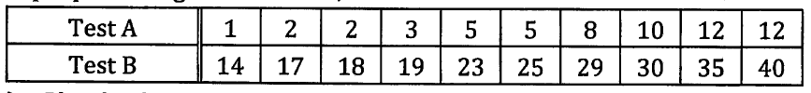
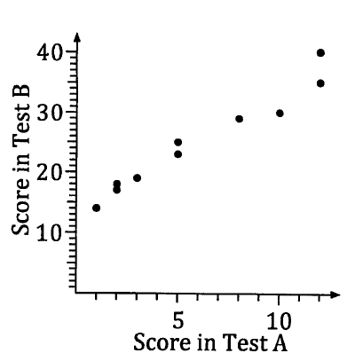
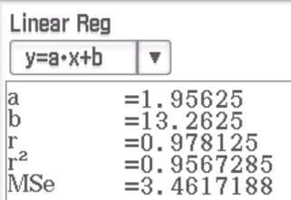
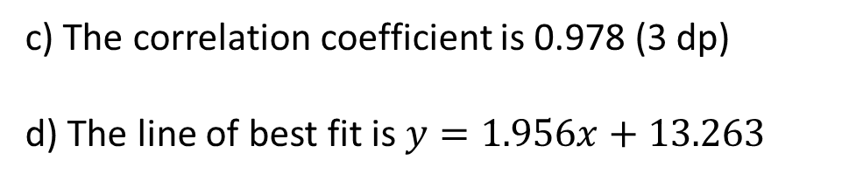
Unit 3 Chapter 2B Example 1
Ten people were given two tests, A and B, and results were as follows.
a) Plot the data as a scatter graph with A as the horizontal axis.
b) Suggest whether the data is suited to a linear model.
c) Determine the correlation coefficient for the 10 pairs of results.
d) Determine the equation of the line of best fit.
e) Predict the test B score for someone who scored 7 on Test A and comment on the validity.
b) The scatter graph suggests a strong positive linear correlation so the data would be suited to a linear model.
c) The correlation coefficient is 0.978 (3 dp)
d) The line of best fit is $y=1.956x+13.263$

Slide 7
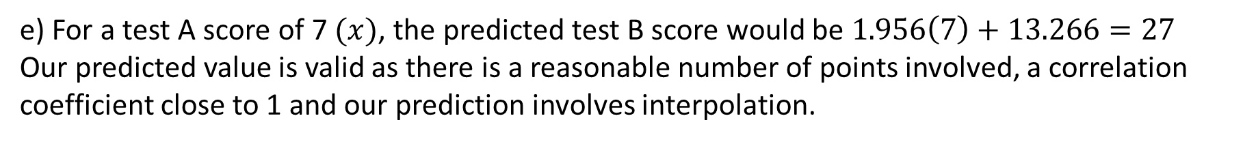
Unit 3 Chapter 2B Example 1
Now try Chapter 2B Q4 – Q11
Ten people were given two tests, A and B, and results were as follows.
a) Plot the data as a scatter graph with A as the horizontal axis.
b) Suggest whether the data is suited to a linear model.
c) Determine the correlation coefficient for the 10 pairs of results.
d) Determine the equation of the line of best fit.
e) Predict the test B score for someone who scored 7 on Test A and comment on the validity.
c) The correlation coefficient is 0.978 (3 dp)
d) The line of best fit is $y=1.956x+13.26$where $y$ is the test B values and $x$ is the test A values
e) For a test A score of 7 $(x)$, the predicted test B score would be $1.956\left(7\right)+13.266=27$
Our predicted value is valid as there is a reasonable number of points involved, a correlation coefficient close to 1 and our prediction involves interpolation.

Slide 8
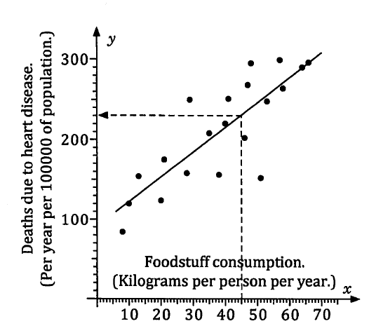
Unit 3 Chapter 2B
Though a scatter graph, and an r value, may suggest that correlation exists between two variables, that does not mean that changes in one variable cause the changes in the other variable.
We found there was correlation between the consumption of a particular food and the death rate due to heart disease. However, we do not know for sure that consumption of the food causes the increased death rate. There could be other factors at work, for example a higher consumption of the food could indicate a country that is more affluent, and may lead a lifestyle that could be the cause of the increased death rate.
This could be considered a lurking or confounding variable that both our two variables have a common response to.
Another example could be that there would be a positive correlation between monthly sales of ice-cream and the montly number of deaths due to drowning. However, one does not cause the other and the lurking variable is likely to be temperature. On hot days, more people buy ice-cream AND more people go swimming, hence the correlation.

Slide 9

Unit 3 Chapter 2B
Now try Chapter 2B Q1 – Q3
Collected data could equally suggest correlation between two variables, but the association could be coincidental.
A person may find that when they buy some seeds to plant in the garden, the weather is then very hot for a few days and the plants die. This is likely to be just coincidence and doesn’t suggest a causal relationship between the two variables.
A company producing cars may find that sales of their cars have been dropping since a particular employee started at the company, but again this is likely to be coincidence, not a causal relationship between sales figures and length of employment.
An observed correlation between two variables does not mean that there is definitely a causal relationship between the variables.
Correlation $≠$causation

Slide 10
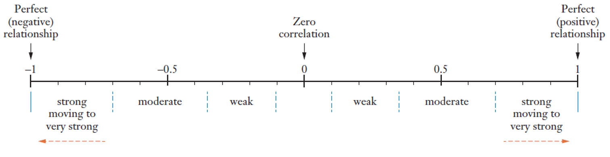
Unit 3 Chapter 2B
As ‘r’ values go from -1 to 1, we might want to know what values are considered to show weak, moderate or strong positive or negative linear correlation.
We can’t just set exact rules as we need to consider:
How many data points were involved?
Have outliers affected the value of r?
What level of r is considered acceptable? For example in the medical industry, a high r value would be needed to suggest a ‘strong’ relationship.
The diagram below gives a general overview to describe relationships from ‘r’ values, but bear in mind that this is not an exact science.

Slide 11
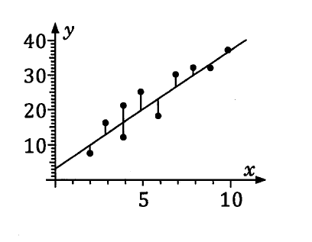


Unit 3 Chapter 2B
The scatter plot shows ten points and their associated line of best fit.
It also shows vertical deviations of each point from the line of best fit,
the difference between obtained y-values and predicted y-values,
known as the linear regression residuals.
Residual = observed y-value – predicted y-value
When a calculator determines the line of best fit, it is minimising the sum of the squares of these residuals.
The line of best fit can also be called the trend line or the least squares regression line.

Slide 12
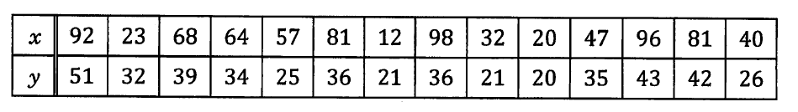
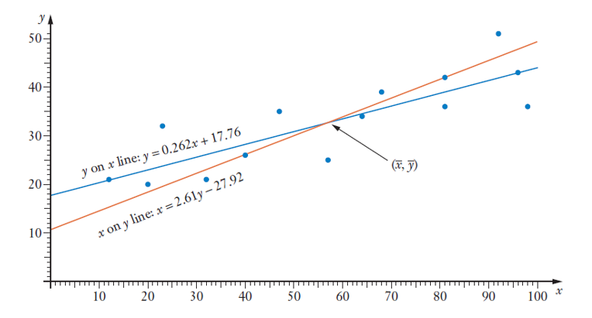
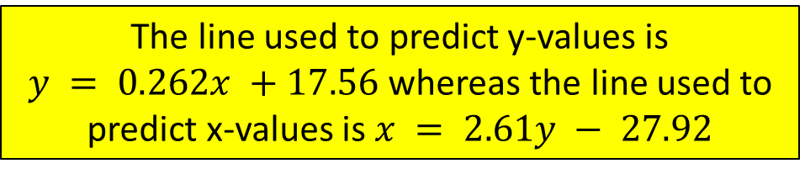
Unit 3 Chapter 2B
We predict values of y using the y on x regression line, determined by minimising the sum of the squares of the vertical deviations of each point from the line. We shouldn’t use this line to predict x values, instead using the x on y regression line, by minimising the sum of the squares of the horizontal deviation of each point from the line.
With the explanatory (or independent) variable as our x values, we would usually want to calculate the y on x regression line and use it to predict y values.
Also, for strong positive or negative linear correlations where the r value is close to 1 or -1, there would be little difference between these lines and no difference at all if r = 1 or -1.
The line used to predict y-values is
$y = 0.262x +17.56$whereas the line used to predict x-values is $x = 2.61y − 27.92$

Slide 13
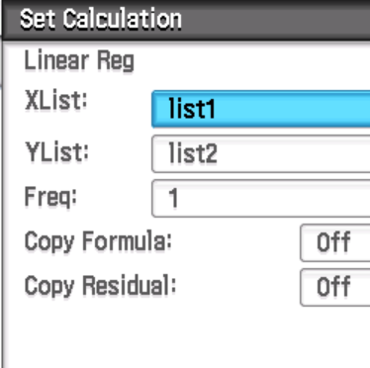
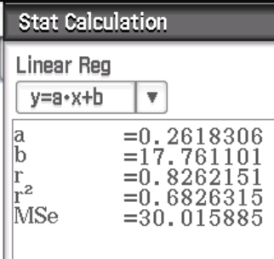
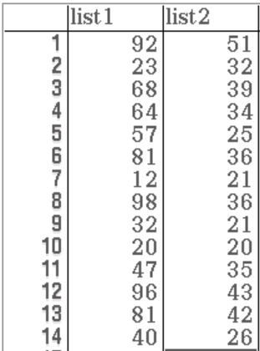
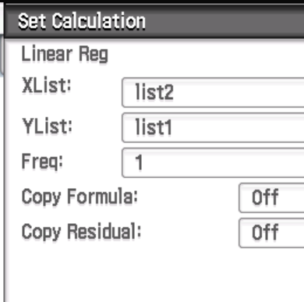
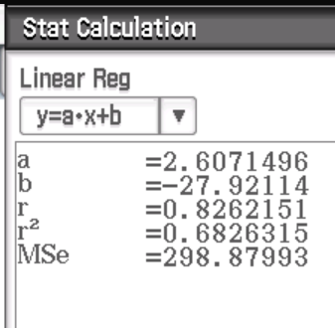
Unit 3 Chapter 2B
Now try Chapter 2B Q12 – Q18
y on x line of best fit
x on y line of best fit

